Slide 1
Mining Association Rules

Slide 2
What are Association Rules?
Study of “what goes with what”
“Customers who bought X also bought Y”
What symptoms go with what diagnosis
Transaction-based or event-based
Also called “market basket analysis” and “affinity analysis”
Initially used for Market Basket Analysis to find how items purchased by customers are related

Slide 3
Basket Data
Retail organizations, e.g., supermarkets, collect and store massive amounts sales data, called basket data.
A record consist of
transaction date
items bought
Or, basket data may consist of items bought by a customer over a period.

Slide 4
Example Association Rule
90% of transactions that purchase bread and butter also purchase milk
Antecedent: bread and butter
Consequent: milk
Confidence factor: 90%

Slide 5
Example Queries
Find all the rules that have “bread” as consequent.
Find all rules that have “Diet Coke” in the antecedent.
Find all rules that have “sausage” in the antecedent and “mustard” in the consequent.
Find all the rules relating items located on shelves A and B in the store.
Find the “best” (most confident) k rules that have “bread” in the consequent.

Slide 6
Applications
Market Basket Analysis: given a database of customer transactions, where each transaction is a set of items the goal is to find groups of items which are frequently purchased together.
Telecommunication (each customer is a transaction containing the set of phone calls)
Credit Cards/ Banking Services (each card/account is a transaction containing the set of customer’s payments)
Medical Treatments (each patient is represented as a transaction containing the ordered set of diseases)
Recommender system

Slide 7
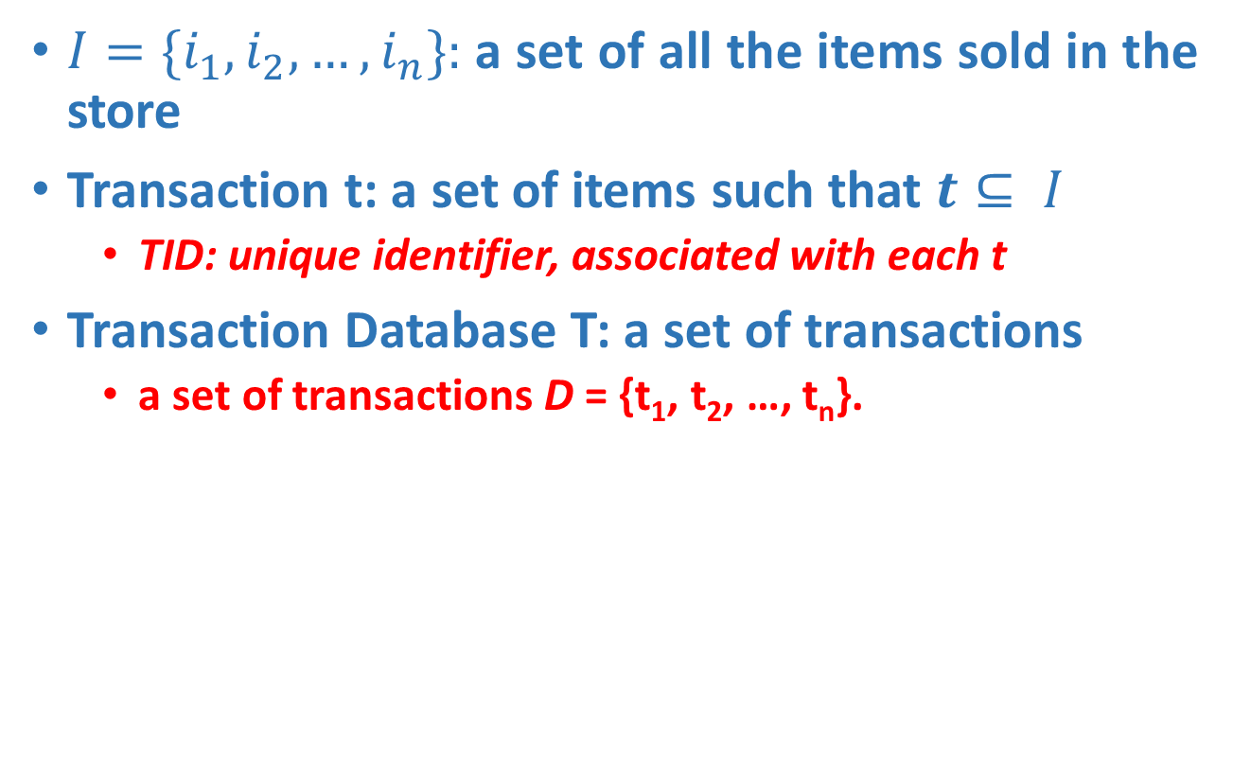
The model: data
$I=\{i_{1}, i_{2}, …, i_{n}\}:$a set of all the items sold in the store
Transaction t: a set of items such that $t⊆ I$
TID: unique identifier, associated with each t
Transaction Database T: a set of transactions
a set of transactions D = {t₁, t₂, …, t_{n}}.

Slide 8
Transaction data: supermarket data
Market basket transactions:
t1: {bread, cheese, milk}
t2: {apple, eggs, salt, yogurt}
… …
tn: {biscuit, eggs, milk}

Slide 9
Transaction data: a set of documents
A text document data set. Each document is treated as a “bag” of keywords
doc1: Student, Teach, School
doc2: Student, School
doc3: Teach, School, City, Game
doc4: Baseball, Basketball
doc5: Basketball, Player, Spectator
doc6: Baseball, Coach, Game, Team
doc7: Basketball, Team, City, Game

Slide 10
The model: rules
A transaction t contains X, a set of items (itemset) in I, if X ⊆ t.
An association rule is an implication of the form:
X → Y, where X, Y ⊂ I, and X ∩Y = ∅
An itemset is a set of items.
E.g., X = {milk, bread, cereal} is an itemset.
A k-itemset is an itemset with k items.
E.g., {milk, bread, cereal} is a 3-itemset

Slide 11
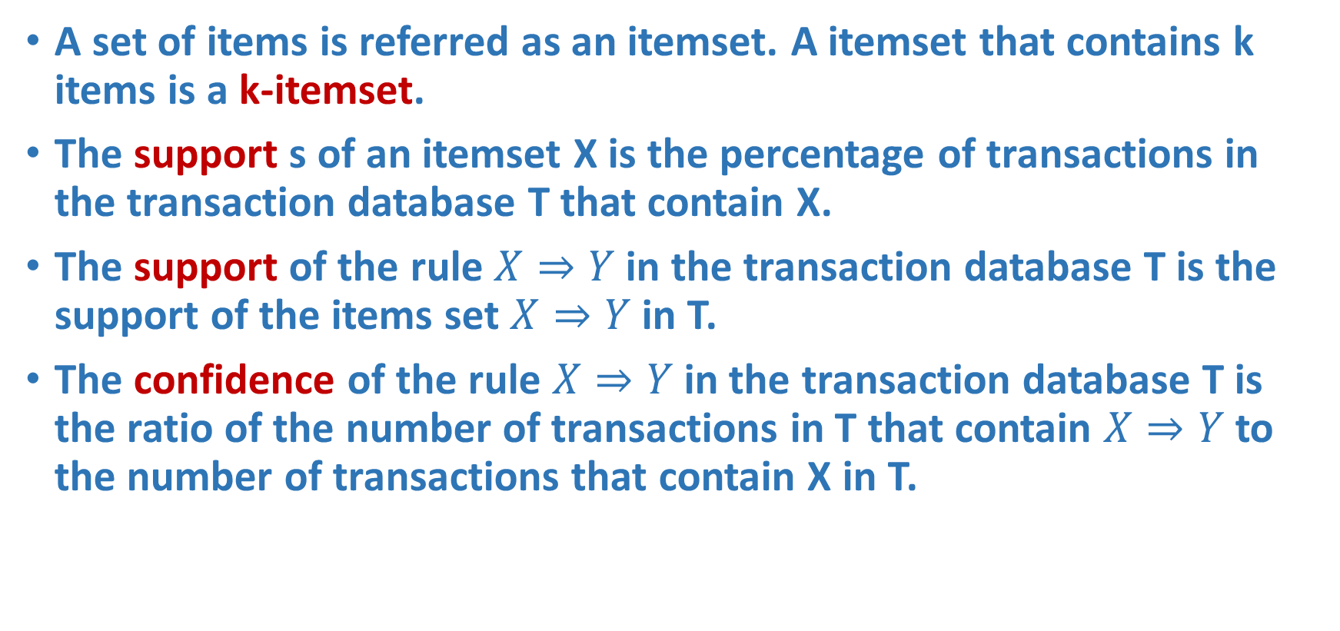
Association Rule Definitions
A set of items is referred as an itemset. A itemset that contains k items is a k-itemset.
The support s of an itemset X is the percentage of transactions in the transaction database T that contain X.
The support of the rule $X⇒Y$in the transaction database T is the support of the items set $X⇒Y$in T.
The confidence of the rule $X⇒Y$in the transaction database T is the ratio of the number of transactions in T that contain $X⇒Y$to the number of transactions that contain X in T.

Slide 12
X->Y
Support=(no of transaction in which x and y both present/total transaction)*100
Confidence=(no of transaction in which x and y both present/no of transaction in which x present)*100

Slide 13
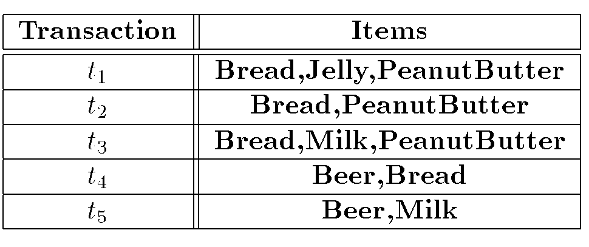
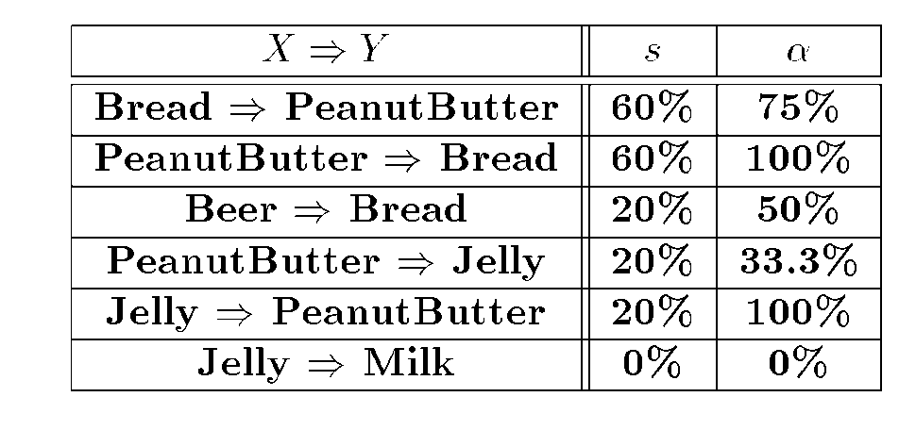
Example
Given a database of transactions:
Find all the association rules:

Slide 14
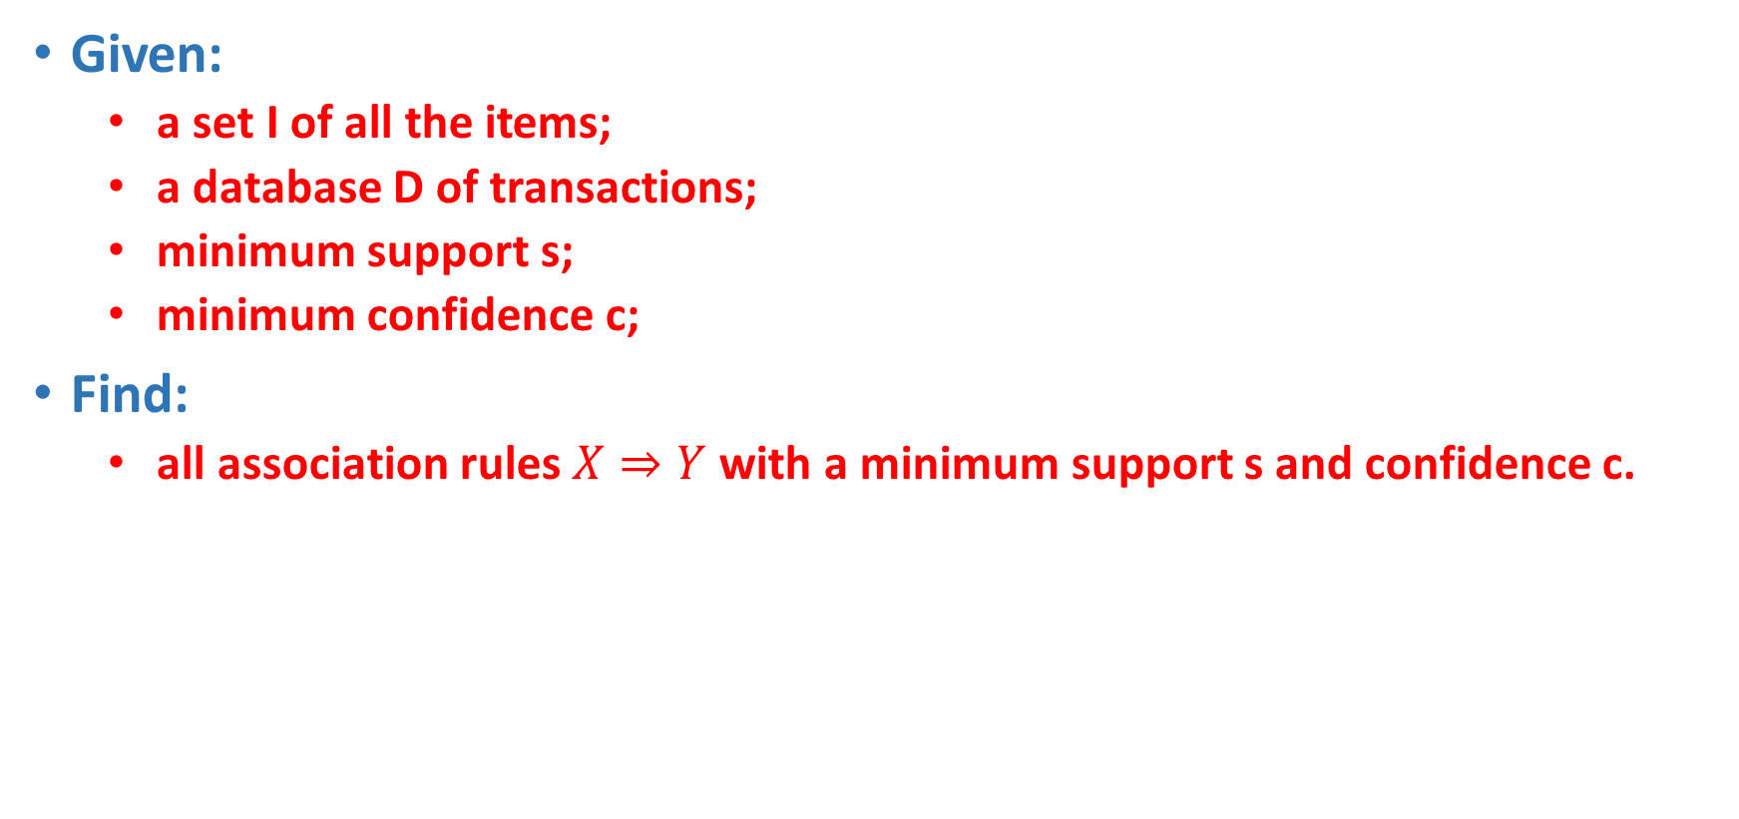
Association Rule Problem
Given:
a set I of all the items;
a database D of transactions;
minimum support s;
minimum confidence c;
Find:
all association rules $X⇒Y$with a minimum support s and confidence c.

Slide 15
Problem Decomposition
Frequent itemsets: Find all sets of items that have minimum support (user defined threshold)
Use the frequent itemsets to generate the desired rules

Slide 16
Problem Decomposition
If the minimum support is 50%, then {Shoes,Jacket} is the only 2- itemset that satisfies the minimum support.
If the minimum confidence is 50%, then the only two rules generated from this 2-itemset, that have confidence greater than 50%, are:
Shoes ⇒ Jacket Support=50%, Confidence=66%
Jacket ⇒ Shoes Support=50%, Confidence=100%

Slide 17
Brute-force algorithm for finding all frequent itemsets?
Generate all possible itemsets (lattice of itemsets)‏
Start with 1-itemsets, 2-itemsets,...,d-itemsets
Compute the frequency of each itemset from the data
Count in how many transactions each itemset occurs
If the support of an itemset is above minimum support report it as a frequent itemset

Slide 18
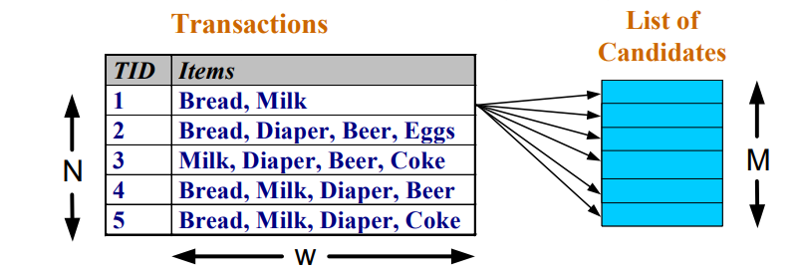

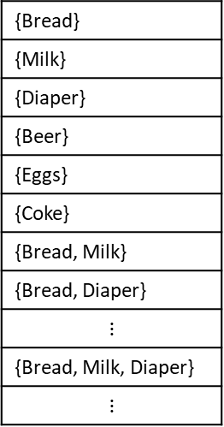
Brute-force algorithm for finding all frequent itemsets?
Complexity?
Match every candidate against each transaction
For M candidates and N transactions, the complexity is~ O(NMw) => Expensive since $M = 2^{d}$!!!
{Bread}
{Milk}
{Diaper}
{Beer}
{Eggs}
{Coke}
{Bread, Milk}
{Bread, Diaper}
$$⋮$$
{Bread, Milk, Diaper}
$$⋮$$

Slide 19
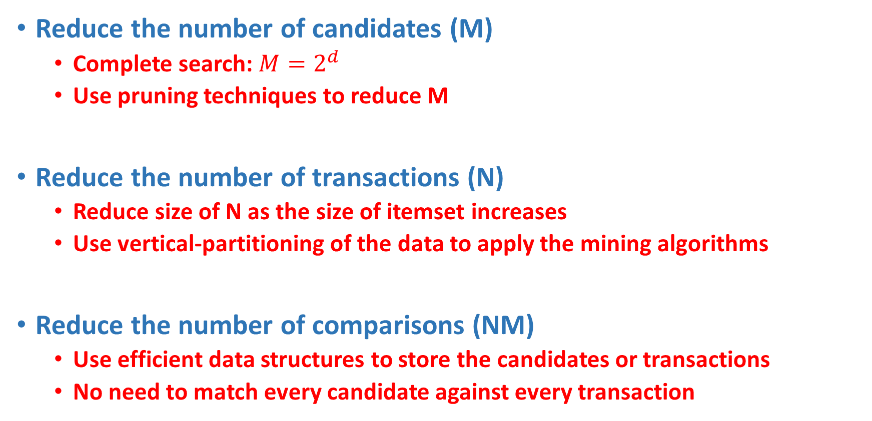
Speeding-up the brute-force algorithm
Reduce the number of candidates (M)‏
Complete search: $M=2^{d}$
Use pruning techniques to reduce M
Reduce the number of transactions (N)‏
Reduce size of N as the size of itemset increases
Use vertical-partitioning of the data to apply the mining algorithms
Reduce the number of comparisons (NM)‏
Use efficient data structures to store the candidates or transactions
No need to match every candidate against every transaction

Slide 20
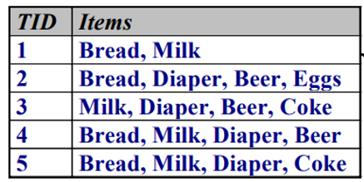
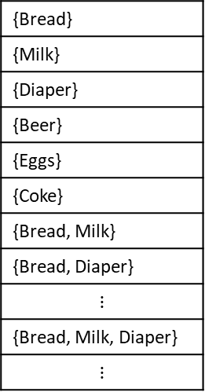
The Apriori Algorithm
Frequent Itemset Property:
Any subset of a frequent itemset is frequent.
Contrapositive:
If an itemset is not frequent, none of its supersets are frequent.
{Bread}
{Milk}
{Diaper}
{Beer}
{Eggs}
{Coke}
{Bread, Milk}
{Bread, Diaper}
$$⋮$$
{Bread, Milk, Diaper}
$$⋮$$

Slide 21
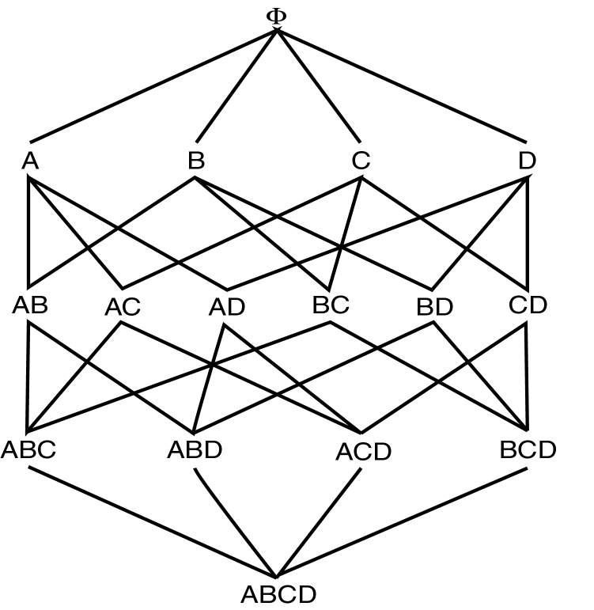
Frequent Itemset Property

Slide 22
The Apriori Algorithm
L_{k}: Set of frequent itemsets of size k (with minimum support)
C_{k}: Set of candidate itemset of size k (potentially frequent itemsets)
L₁ = {frequent items};
for (k = 1; L_{k} !=∅; k++) do
C_{k+1} = candidates generated from L_{k};
for each transaction t in database do
increment the count of all candidates in C_{k+1} that are contained in t
L_{k+1} = candidates in C_{k+1} with minimum support
return ∪_{k} L_{k};

Slide 23
The Apriori Algorithm—An Example
Sup_{min} = 2
Itemset | sup
{A} | 2
{B} | 3
{C} | 3
{D} | 1
{E} | 3
Database TDB
Itemset | sup
{A} | 2
{B} | 3
{C} | 3
{E} | 3
L₁
Tid | Items
10 | A, C, D
20 | B, C, E
30 | A, B, C, E
40 | B, E
C₁
1st scan
C₂
Itemset | sup
{A, B} | 1
{A, C} | 2
{A, E} | 1
{B, C} | 2
{B, E} | 3
{C, E} | 2
C₂
Itemset
{A, B}
{A, C}
{A, E}
{B, C}
{B, E}
{C, E}
L₂
Itemset | sup
{A, C} | 2
{B, C} | 2
{B, E} | 3
{C, E} | 2
2nd scan
C₃
Itemset
{B, C, E}
3rd scan
L₃
Itemset | sup
{B, C, E} | 2

Slide 24
The Apriori Algorithm — Example
Min support =50%
Database D
L₁
C₁
Scan D
C₂
C₂
L₂
Scan D
C₃
Scan D
L₃

Slide 25
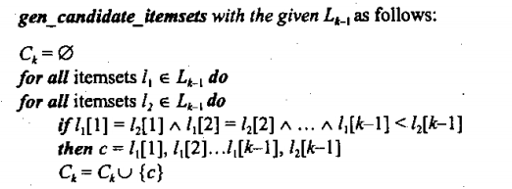
How to Generate Candidates
L3={abc, abd, acd, ace, bcd}
Generating C4 from L3
abcd from abc and abd
acde from acd and ace
Pruning:
acde is removed because ade is not in L3
C4={abcd}

Slide 26
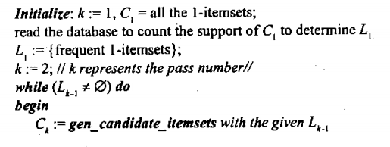
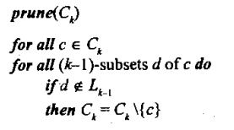
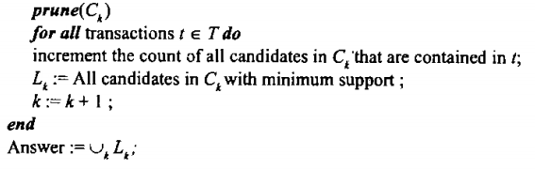
The Apriori Algorithm

Slide 27
Example of Discovering Rules
Let us consider the 3-itemset {I1, I2, I5}:
Possible Rules
I1 ∧ I2 ⇒ I5
I1 ∧ I5 ⇒ I2
I2 ∧ I5 ⇒ I1
I1 ⇒ I2 ∧ I5
I2 ⇒ I1 ∧ I5
I5 ⇒ I1 ∧ I2

Slide 28
Discovering Rules
for each frequent itemset I do
for each subset C of I do [ (I - C) ⇒ C ]
if (support(I) / support(I - C) >= minimum confidence) then
output the rule (I - C) ⇒ C,
with confidence = support(I) / support (I - C)
and support = support(I)

Slide 29
Example of Discovering Rules
Let use consider the 3-itemset {I1, I2, I5} with support of 0.22(2)%. Let generate all the association rules from this itemset:
I1 ∧ I2 ⇒ I5 confidence= 2/4 = 50%
I1 ∧ I5 ⇒ I2 confidence= 2/2 = 100%
I2 ∧ I5 ⇒ I1 confidence= 2/2 = 100%
I1 ⇒ I2 ∧ I5 confidence= 2/6 = 33%
I2 ⇒ I1 ∧ I5 confidence= 2/7 = 29%
I5 ⇒ I1 ∧ I2 confidence= 2/2 = 100%
TID | List of Item_IDs
T100 | I1, I2, I5
T200 | I2, I4
T300 | I2, I3
T400 | I1, I2, I4
T500 | I1, I3
T600 | I2, I3
T700 | I1, I3
T800 | I1, I2, I3, I5
T900 | I1, I2, I3

Slide 30
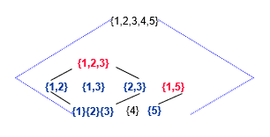
Maximal Frequent set, Boarder set
Maximal Frequent set
A frequent set is maximal frequent set if it is a frequent set and no superset of this is a frequent set
The set of all maximal frequent set can act as a compact representation of the all frequent sets
Boarder set
An itemset is a boarder set if it is not a frequent set, but all its proper subsets are frequent sets
Question: Maximal frequent set?
tid itemset
1 {1,2,3,5}
2 {1,5}
3 {1,2}
4 {1,2,3}

Slide 31
Maximum Frequent Set-> maximum length vale combination jiska support min support se zyda ya equal ho to vo min frequent set hoga
Border Frequent Set-> maximum length vale combination jiska support min support se kam hoga lakin uske saare proper subset ka support min support se zyda ya equal hoga

Slide 32
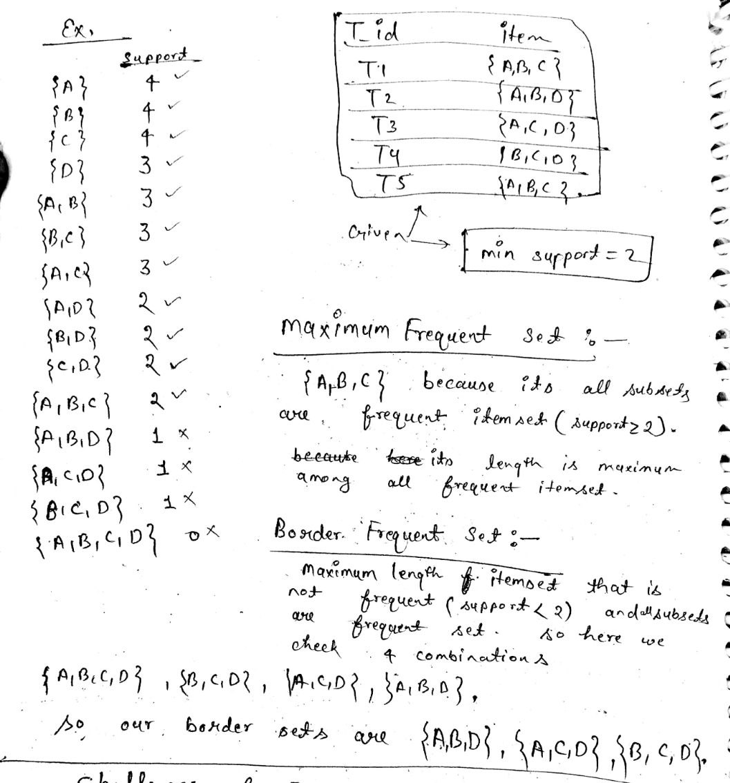

Slide 33
Challenges of Frequent Pattern Mining
Challenges
Multiple scans of transaction database
Huge number of candidates
Tedious workload of support counting for candidates
Improving Apriori: general ideas
Reduce passes of transaction database scans
Shrink number of candidates
Facilitate support counting of candidates

Slide 34
Partition Algorithm
The partition algorithm is based on the observation that the frequent sets are normally very few in number compared to the set of all itemsets
As a result, if we partition the set of transactions to smaller segments such that each segment can be accommodated in the main memory, then we can compute the set of frequent sets of each of these partition
Since each partition can fit in the main memory, there will be no additional disk I/O for each partition after loading the partition into the main memory

Slide 35
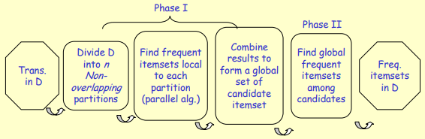
Partition: Scan Database Only Twice
Any itemset that is potentially frequent in DB must be frequent in at least one of the partitions of DB
Scan 1: partition database and find local frequent patterns
Scan 2: consolidate global frequent patterns

Slide 36
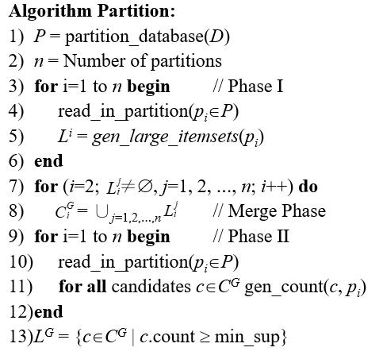
Partition Algorithm
The local large itemsets, L^{i} , can be found by using a level-wise algorithm such as Apriori.

Slide 37
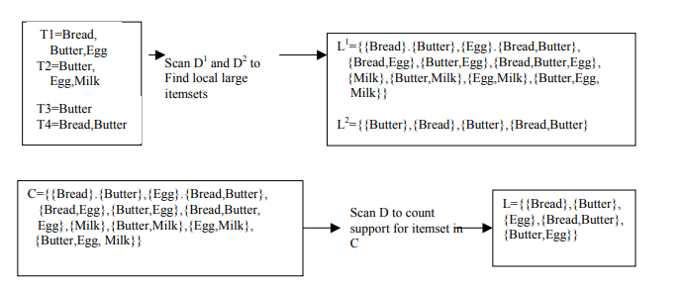
Partition Algorithm - Example
TID | Items
t₁ | Bread, Butter, Eggs
t₂ | Butter, Eggs, Milk
t₃ | Butter
t₄ | Bread, Butter

Slide 38
Pruning
Pruning can reduce the size of the candidate set C_{k}. We want to transform C_{k} into a set of frequent items L_{k}. To reduce the work of checking, we may use the rule that all subsets of C_{k} must also be frequent.
Example
Suppose the items are A, B, C, D, E, F, .., X, Y, Z
Suppose L₁ is A, C, E, P, Q, S, T, V, W, X
Suppose L₂ is {A, C}, {A, F}, {A, P}, {C, P}, {E, P},
{E, G}, {E, V}, {H, J}, {K, M}, {Q, S}, {Q, X}
Are you able to identify errors in the L₂ list?
What is C₃?
How to prune C₃?
C₃ is {A, C, P}, {E, P, V}, {Q, S, X}

Slide 39
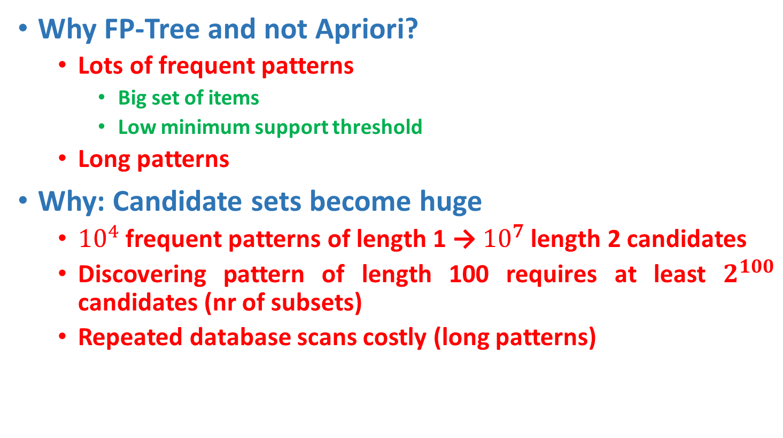
FP-tree Growth Algorithm
Why FP-Tree and not Apriori?
Lots of frequent patterns
Big set of items
Low minimum support threshold
Long patterns
Why: Candidate sets become huge
${10}^{4}$ frequent patterns of length 1 → ${10}^{7}$ length 2 candidates
Discovering pattern of length 100 requires at least $2^{100}$ candidates (nr of subsets)
Repeated database scans costly (long patterns)

Slide 40
FP-tree Growth Algorithm
FP-Growth: allows frequent itemset discovery without candidate itemset generation. Two step approach
Step 1: Build a compact data structure called the FP-tree
Built using 2 passes over the data-set.
A frequent pattern tree (FP-tree) is a tree structure consisting of an item-prefix-tree and a frequent-item-header table
Step 2: Extracts frequent itemsets directly from the FP-tree

Slide 41
Step 1: FP-Tree Construction
FP-Tree is constructed using 2 passes over the data-set
Pass 1:
Scan data and find support for each item.
Discard infrequent items.
Sort frequent items in decreasing order based on their support.
Use this order when building the FP-Tree, so common prefixes can be shared.
In FP-Tree, nodes correspond to items and have a counter

Slide 42
Step 1: FP-Tree Construction
Pass 2:
FP-Growth reads 1 transaction at a time and maps it to a path
Fixed order is used, so paths can overlap when transactions share items (when they have the same prefix ).
In this case, counters are incremented
Pointers are maintained between nodes containing the same item, creating singly linked lists (dotted lines)
The more paths that overlap, the higher the compression. FP-tree may fit in memory.
Frequent itemsets extracted from the FP-Tree.

Slide 43
Step 1: FP-Tree Construction (Example)
Transactions
Freq. 1-Itemsets.
Supp. Count ≥2
Transactions with items sorted based on frequencies, and ignoring the infrequent items.
A B C E F O
A C G
E I
A C D E G
A C E G L
E J
A B C E F P
A C D
A C E G M
A C E G N
A:8
C:8
E:8
G:5
B:2
D:2
F:2
A C E B F
A C G
E
A C E G D
A C E G
E
A C E B F
A C D
A C E G
A C E G

Slide 44
FP-Tree after reading 1st transaction
A C E B F
A C G
E
A C E G D
A C E G
E
A C E B F
A C D
A C E G
A C E G
Header
null
A:8
C:8
E:8
G:5
B:2
D:2
F:2
A:1
C:1
E:1
B:1
F:1

Slide 45
FP-Tree after reading 2nd transaction
A C E B F
A C G
E
A C E G D
A C E G
E
A C E B F
A C D
A C E G
A C E G
Header
null
A:8
C:8
E:8
G:5
B:2
D:2
F:2
A:2
C:2
E:1
G:1
B:1
F:1

Slide 46
FP-Tree after reading 3rd transaction
A C E B F
A C G
E
A C E G D
A C E G
E
A C E B F
A C D
A C E G
A C E G
Header
null
A:8
C:8
E:8
G:5
B:2
D:2
F:2
A:2
E:1
C:2
E:1
G:1
B:1
F:1

Slide 47
FP-Tree after reading 4th transaction
A C E B F
A C G
E
A C E G D
A C E G
E
A C E B F
A C D
A C E G
A C E G
Header
null
A:8
C:8
E:8
G:5
B:2
D:2
F:2
A:3
E:1
C:3
E:2
G:1
G:1
B:1
F:1
D:1

Slide 48
FP-Tree after reading 5th transaction
A C E B F
A C G
E
A C E G D
A C E G
E
A C E B F
A C D
A C E G
A C E G
Header
null
A:8
C:8
E:8
G:5
B:2
D:2
F:2
A:4
E:1
C:4
E:3
G:1
G:2
B:1
F:1
D:1

Slide 49
FP-Tree after reading 6th transaction
A C E B F
A C G
E
A C E G D
A C E G
E
A C E B F
A C D
A C E G
A C E G
Header
null
A:8
C:8
E:8
G:5
B:2
D:2
F:2
A:4
E:2
C:4
E:3
G:1
G:2
B:1
F:1
D:1

Slide 50
FP-Tree after reading 7th transaction
A C E B F
A C G
E
A C E G D
A C E G
E
A C E B F
A C D
A C E G
A C E G
Header
null
A:8
C:8
E:8
G:5
B:2
D:2
F:2
A:5
E:2
C:5
E:4
G:1
G:2
B:2
F:2
D:1

Slide 51
FP-Tree after reading 8th transaction
A C E B F
A C G
E
A C E G D
A C E G
E
A C E B F
A C D
A C E G
A C E G
Header
null
A:8
C:8
E:8
G:5
B:2
D:2
F:2
A:6
E:2
C:6
E:4
G:1
D:1
G:2
B:2
F:2
D:1

Slide 52
FP-Tree after reading 9th transaction
A C E B F
A C G
E
A C E G D
A C E G
E
A C E B F
A C D
A C E G
A C E G
Header
null
A:8
C:8
E:8
G:5
B:2
D:2
F:2
A:7
E:2
C:7
E:5
G:1
D:1
G:3
B:2
F:2
D:1

Slide 53
FP-Tree after reading 10th transaction
A C E B F
A C G
E
A C E G D
A C E G
E
A C E B F
A C D
A C E G
A C E G
Header
null
A:8
C:8
E:8
G:5
B:2
D:2
F:2
A:8
E:2
C:8
E:6
G:1
D:1
G:4
B:2
F:2
D:1

Slide 54
FP-Tree size
The FP-Tree usually has a smaller size than the uncompressed data - typically many transactions share items (and hence prefixes).
Best case scenario: all transactions contain the same set of items.
1 path in the FP-tree
Worst case scenario: every transaction has a unique set of items (no items in common)
Size of the FP-tree is at least as large as the original data.
Storage requirements for the FP-tree are higher - need to store the pointers between the nodes and the counters.
The size of the FP-tree depends on how the items are ordered
Ordering by decreasing support is typically used but it does not always lead to the smallest tree (it's a heuristic).

Slide 55
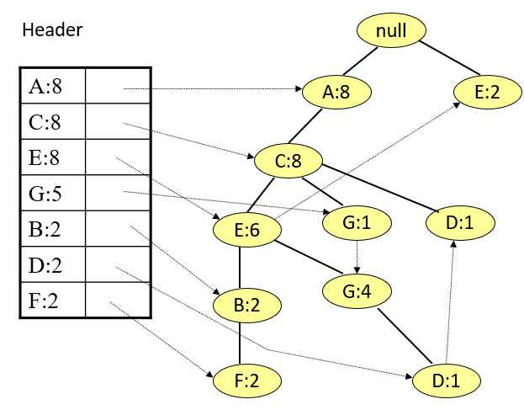
Step 2: Frequent Itemset Generation
FP­ growth generates frequent itemsets from an FP­ tree by exploring the tree in a bottom­ up fashion - from the leaves towards the root
Divide and conquer: first look for frequent itemsets ending in F, then BF, etc. . . then D, then GD, etc. . .
First, extract prefix path sub-trees ending in an item(set).

Slide 56
3 Major Steps
Starting the processing from the end of list L:
Step1:
Construct conditional pattern base for each item in the header table
Step 2:
Construct conditional FP-tree from each conditional for each pattern base
Step 3:
Recursively mine conditional FP-trees and grow frequent patterns obtained so far. If the conditional FP-tree contains a single path, simply enumerate all the patterns

Slide 57
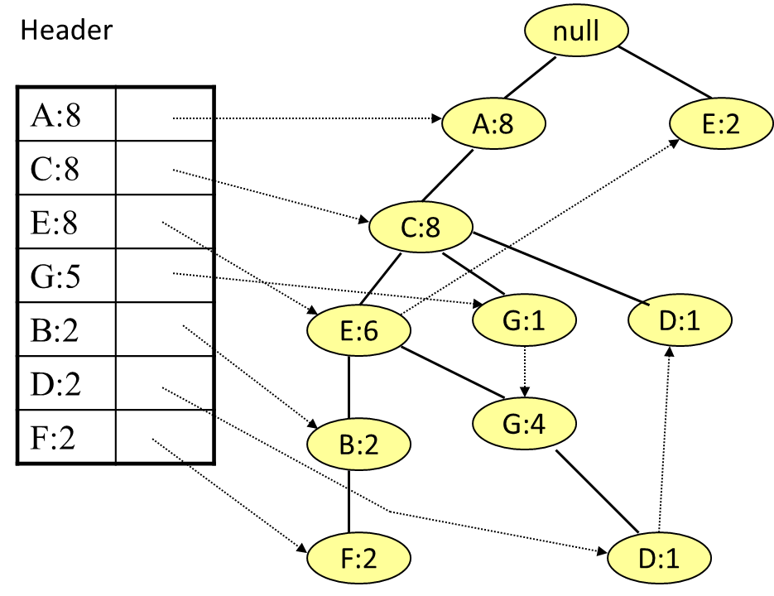
Step 1: Construct Conditional Pattern Base
Starting at the bottom of frequent-item header table in the FP-tree
Traverse the FP-tree by following the link of each frequent item
Accumulate all of transformed prefix paths of that item to form a conditional pattern base
Conditional pattern bases
item cond. pattern base
F ACEB:2
D ACEG:1, AC:1
B ACE:2
G ACE: 4, AC:1,
E AC:6
C A:8
A { }

Slide 58
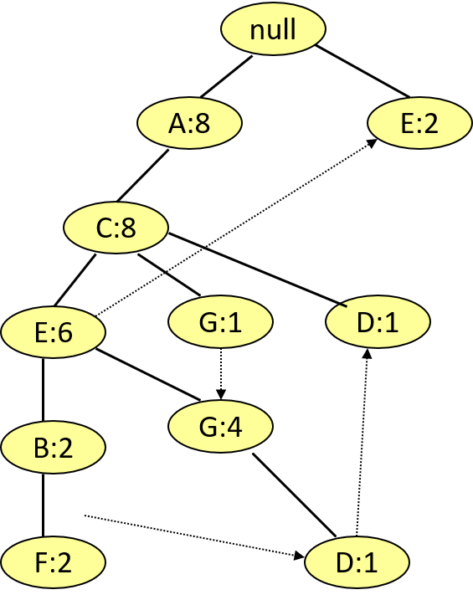
null
null
null
A:2
A:2
A:2
C:2
C:2
C:2
E:2
E:2
+ B
E:1
B:2
G:1
+ D
Conditional pattern bases
item cond. pattern base
F ACEB:2
D ACEG:1, AC:1
B ACE:2
G ACE: 4, AC:1,
E AC:6
C A:8
A { }
+ F
null
null
null
A:5
A:6
A:8
+ C
C:5
C:6
+ E
A:8
E:4
+ G

Slide 59
Step 2: Construct Conditional FP Tree
A C
{}
A C
A C
{}
A C
A C
A C
A
A
A
A
A
A
A
A
A C E B
A C E B
A C E G
A C
A C E
A C E
A C
A C E
A C E
A C E
A C E
+ F
+ D
+ B
A C E B F
A C G
E
A C E G D
A C E G
E
A C E B F
A C D
A C E G
A C E G
+ G
+ E
+ C
A C E B
A C G
E
A C E G D
A C E G
E
A C E B
A C D
A C E G
A C E G
A C E B
A C G
E
A C E G
A C E G
E
A C E B
A C
A C E G
A C E G
A C E
A C G
E
A C E G
A C E G
E
A C E
A C
A C E G
A C E G
A C E
A C
E
A C E
A C E
E
A C E
A C
A C E
A C E
A C
A C
{}
A C
A C
{}
A C
A C
A C
A C
A:1,2,4,5,6,7,8,9,10

Slide 60
A C E B
A C E B
+ F
A C E G
A C
min_sup = 3
+ D
A C E B F
A C G
E
A C E G D
A C E G
E
A C E B F
A C D
A C E G
A C E G
A C E
A C E
+ B
G: 5 AG: 5 CG: 5 EG: 4 ACG: 5 AEG: 4 CEG: 4 ACEG: 4
A C
A C E
A C E
A C E
A C E
A C
A C E
A C E
A C E
A C E
+ G
+ G

Slide 61
A C
{}
A C
A C
{}
A C
A C
A C
A C
{}
A C
A C
{}
A C
A C
A C
E: 8 AE: 6 CE: 6 ACE: 6
min_sup = 3
+ E
+ E
A C E B F
A C G
E
A C E G D
A C E G
E
A C E B F
A C D
A C E G
A C E G
A
A
A
A
A
A
A
A
A
A
A
A
A
A
A
A
C: 8 AC: 8
A:8
+ C
+ C

Slide 62
Sampling for Frequent Patterns
A sample which can fit in the main memory is first drawn from the database.
The set of large itemsets in the sample is then found from this sample by using a level-wise algorithm such as Apriori.
Let the set of large itemsets in the sample be PL, which is used as a set of probable large itemsets and used to generate candidates which are to be verified against the whole database .

Slide 63
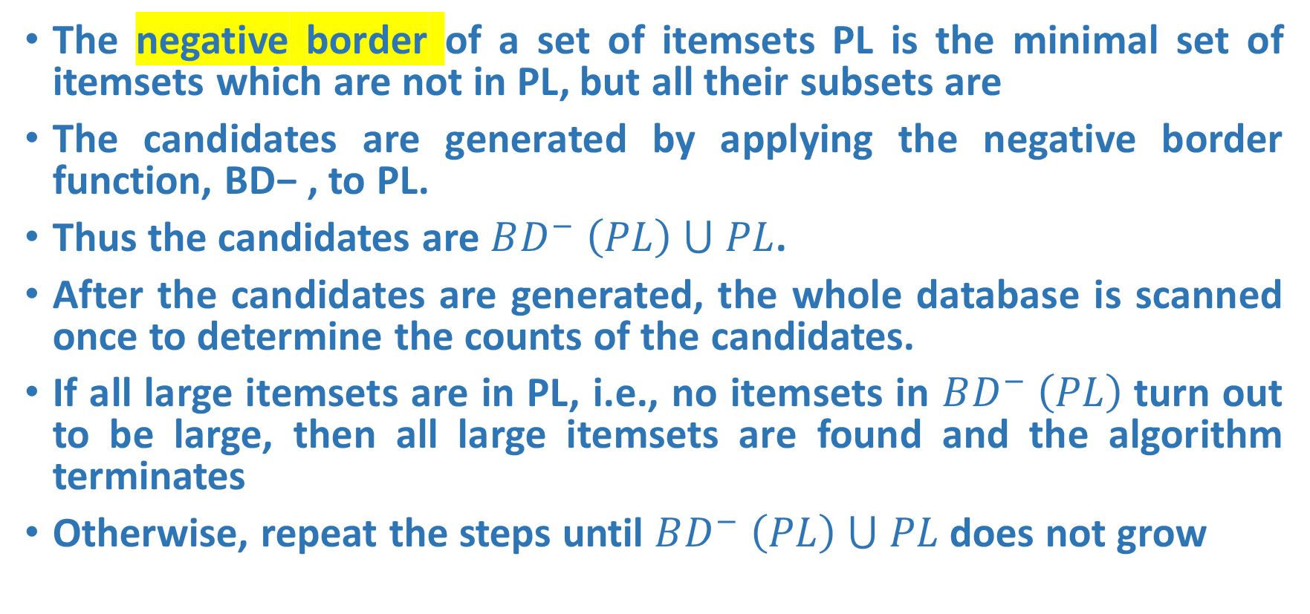
Sampling for Frequent Patterns
The negative border of a set of itemsets PL is the minimal set of itemsets which are not in PL, but all their subsets are
The candidates are generated by applying the negative border function, BD− , to PL.
Thus the candidates are $BD^{−} \left(PL\right) ⋃ PL$.
After the candidates are generated, the whole database is scanned once to determine the counts of the candidates.
If all large itemsets are in PL, i.e., no itemsets in $BD^{−} \left(PL\right)$turn out to be large, then all large itemsets are found and the algorithm terminates
Otherwise, repeat the steps until $BD^{−} \left(PL\right) ⋃ PL$ does not grow

Slide 64
Pattern Evaluation
Association rule algorithms can produce large number of rules
Interestingness measures can be used to prune/rank the patterns
In the original formulation, support & confidence are the only measures used

Slide 65
Computing Interestingness Measure
Given X → Y or {X,Y}, information needed to compute interestingness can be obtained from a contingency table
Contingency table
 | Y | Y
X | f₁₁ | f₁₀ | f₁₊
X | f₀₁ | f₀₀ | f_{o+}
 | f₊₁ | f₊₀ | N
f₁₁: support of X and Y f₁₀: support of X and Y f₀₁: support of X and Y f₀₀: support of X and Y
Used to define various measures
support, confidence, Gini, entropy, etc.

Slide 66
Drawback of Confidence
Customers | Tea | Coffee | …
C1 | 0 | 1 | …
C2 | 1 | 0 | …
C3 | 1 | 1 | …
C4 | 1 | 0 | …
…
Association Rule: Tea → Coffee
Confidence ≅ P(Coffee|Tea) = 150/200 = 0.75
Confidence > 50%, meaning people who drink tea are more likely to drink coffee than not drink coffee
So rule seems reasonable

Slide 67
Drawback of Confidence
 | Coffee | Coffee
Tea | 150 | 50 | 200
Tea | 650 | 150 | 800
 | 800 | 200 | 1000
Association Rule: Tea → Coffee
Confidence= P(Coffee|Tea) = 150/200 = 0.75
but P(Coffee) = 0.8, which means knowing that a person drinks tea reduces the probability that the person drinks coffee!
Note that P(Coffee|Tea) = 650/800 = 0.8125

Slide 68
Drawback of Confidence
Customers | Tea | Honey | …
C1 | 0 | 1 | …
C2 | 1 | 0 | …
C3 | 1 | 1 | …
C4 | 1 | 0 | …
…
Association Rule: Tea → Honey Confidence ≅ P(Honey|Tea) = 100/200 = 0.50
Confidence = 50%, which may mean that drinking tea has little influence whether honey is used or not
So rule seems uninteresting
But P(Honey) = 120/1000 = .12 (hence tea drinkers are far more likely to have honey

Slide 69
Measure for Association Rules
So, what kind of rules do we really want?
Confidence(X → Y) should be sufficiently high
To ensure that people who buy X will more likely buy Y than not buy Y
Confidence(X → Y) > support(Y)
Otherwise, rule will be misleading because having item X actually reduces the chance of having item Y in the same transaction
Is there any measure that capture this constraint?
Answer: Yes. There are many of them.

Slide 70
Statistical Relationship between X and Y
The criterion confidence(X → Y) = support(Y)
is equivalent to:
P(Y|X) = P(Y)
P(X,Y) = P(X) × P(Y) (X and Y are independent)
If P(X,Y) > P(X) × P(Y) : X & Y are positively correlated
If P(X,Y) < P(X) × P(Y) : X & Y are negatively correlated

Slide 71
Measures that take into account statistical dependence
lift is used for rules while interest is used for itemsets

Slide 72
Example: Lift/Interest
 | Coffee | Coffee
Tea | 150 | 50 | 200
Tea | 650 | 150 | 800
 | 800 | 200 | 1000
Association Rule: Tea → Coffee
Confidence= P(Coffee|Tea) = 0.75
but P(Coffee) = 0.8
Interest = 0.15 / (0.2×0.8) = 0.9375 (< 1, therefore is negatively associated)
So, is it enough to use confidence/Interest for pruning?

Slide 73
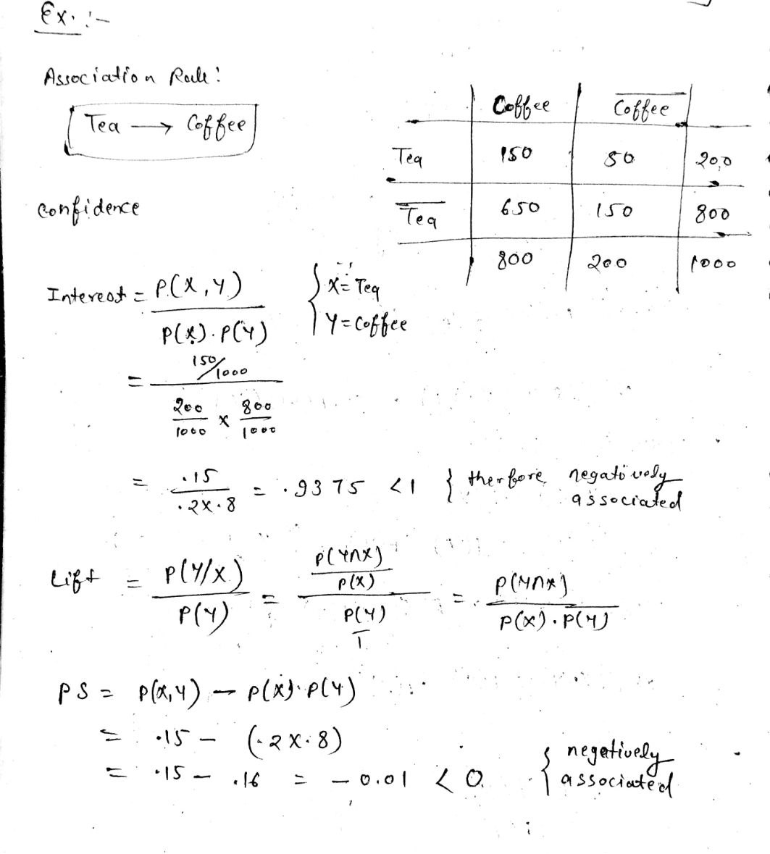

Slide 74
More measures proposed in the literature
There are lots of measures proposed in the literature

